Slide 1
Bringing data science and AI/ML tools to infectious disease research
Session 1: Introduction to Drug Discovery

Slide 2
Outline
Drug discovery pipeline
Screening methods
Intro to ADME/DMPK
Chemical properties
Examples of AI/ML at H3D

Slide 3
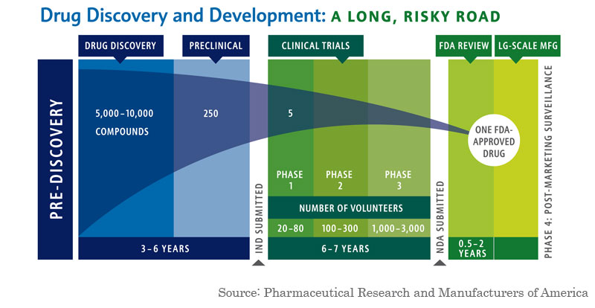
Drug Discovery Pipeline
Average cost = $1.3 billion*
Wouters OJ, McKee M, Luyten J. Estimated Research and Development Investment Needed to Bring a New Medicine to Market, 2009-2018. JAMA. 2020;323(9):844–853. doi:10.1001/jama.2020.1166

Slide 4
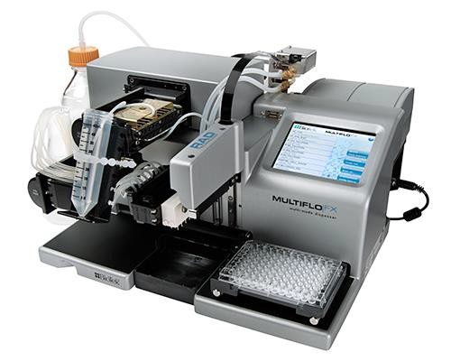
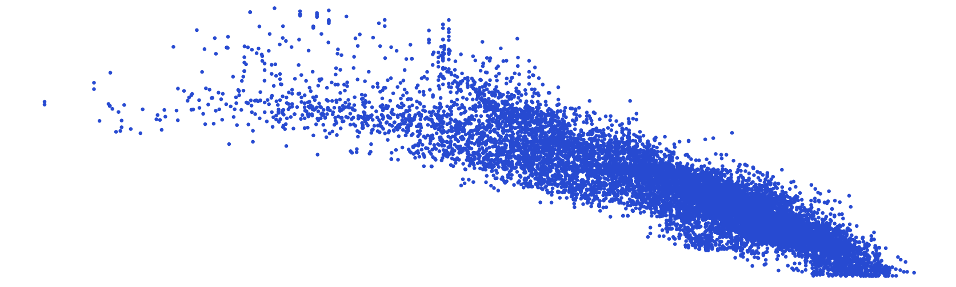
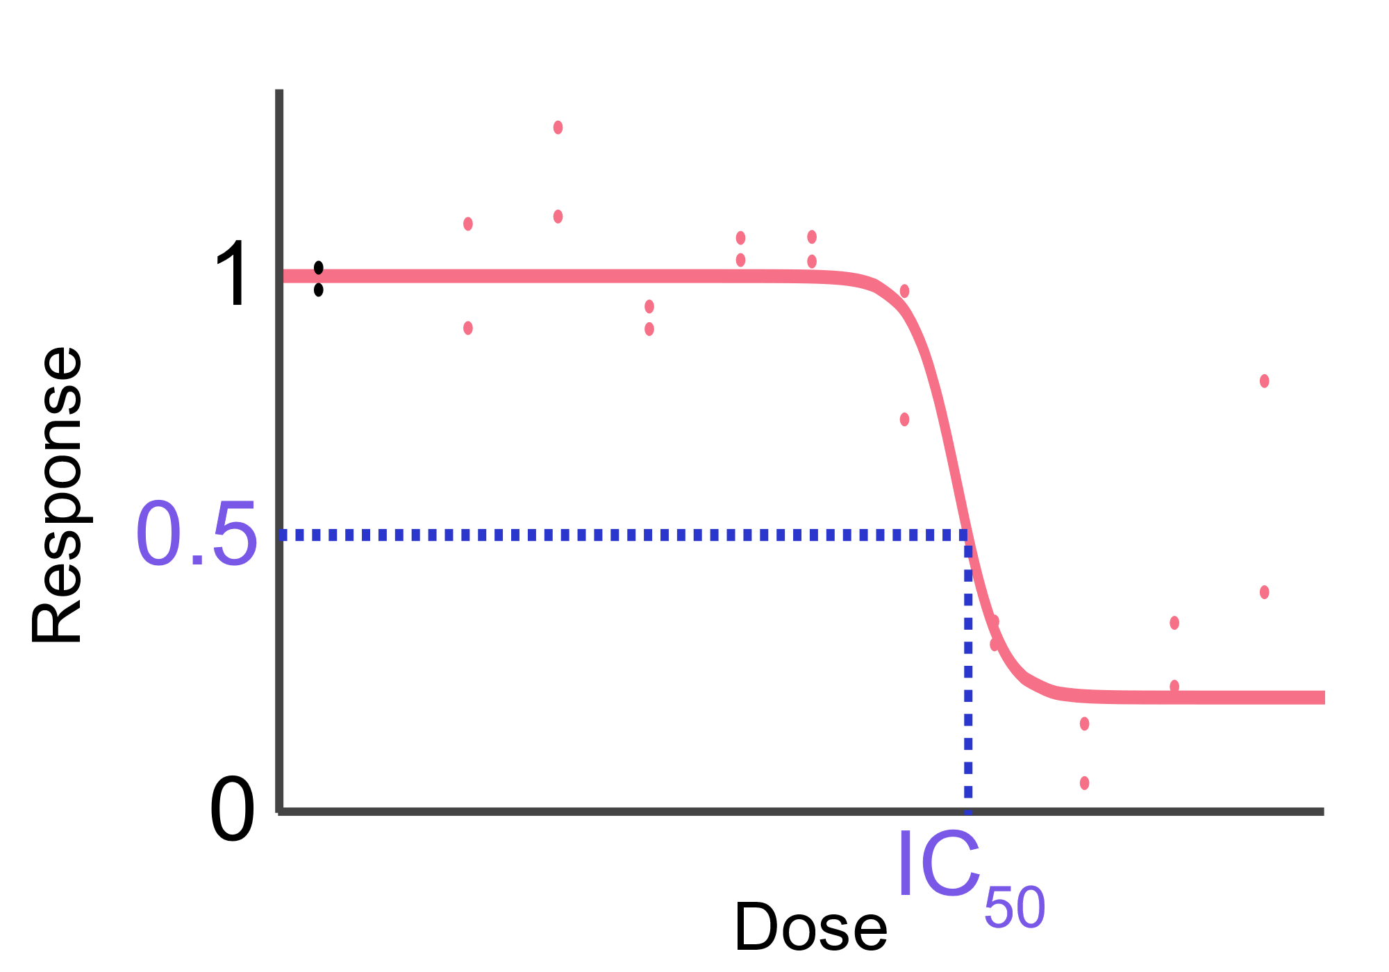
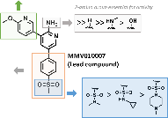
Drug Discovery Pipeline
Screening
HTS of compound library
SP whole cell assay
SP Biochemical assay (target-based)
Chemical tractability
Clustering and prioritization
SWOT analysis
Lead Optimisation (LO)
Potent analogues
Solubility
Cytotoxicity
Metabolic stability
hERG
Rodent/Dog PK
Safety pharmacology (Safety44/kinase panel)
In vivo efficacy
Target ID known
PK/PD studies
Human dose predictions
Formal Hit Assessment (FHA)
Define minimal pharmacophore
Scope out SAR/SPR (~ 30 cds)
Profile in primary ADMET assays
Screening Active
Hit Series
Late Lead
Screening
Hit
Validation
Formal Hit
Assessment
Hit to Lead
Lead Optimisation
Candidate Profiling
Pre-clinical
development
Clinical
development
Validated Hit
Early Lead
Back-ups
Candidate
Hit Validation
Resynthesis of hits
IC50/MIC90 determination
Mutant screening
Primary ADMET assays (solubility, cytotox, microsomal stability)
Resistance panel
Hit to Lead (H2L)
Improved potency with SAR
Solubility
Cytotoxicity
Chemical/metabolic stability
Permeability
CYP inhibition
Binding assays
Rodent PK studies
POC in animal model
Target ID
Candidate Profiling
1 – 3 frontrunners
Large scale-up of compounds
Non-GLP exploratory rat and dog tox. study
Secondary pharmacology panel/Bioprofiling
CMC Studies
Refine human dose predictions

Slide 5
AI/ML Applications in Drug Discovery
Screening
Hit
Validation
Formal Hit
Assessment
Hit to Lead
Lead Optimisation
Candidate Profiling
Pre-clinical
development
Clinical
development
Virtual Screening
QSAR for Biological Activity
Design Clinical Trials
Scoring Profiles
Predicting ADMET Properties
Improve Patient Selection
Evaluating Chemical Space
De novo drug Design
Patient Monitoring
Calculating Physicochemical Properties
Reduce costs
Speed up timelines
Reduce number of compounds synthesized
Reduce number of animals used

Slide 6
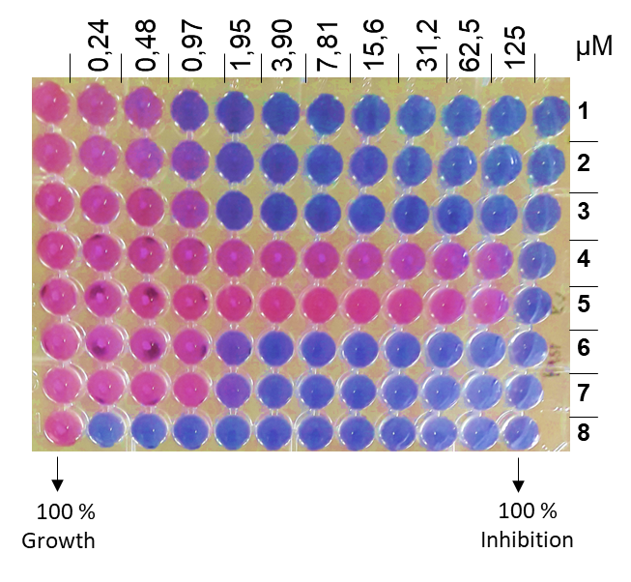
Screening Methods
Phenotypic Screening:
Whole-cell assay
Assume physiological relevance
Physicochemical properties of hits NB – need to get into cell
No assumption of target/pathway/mechanisms (efficacy and toxicity)
Target deconvolution – elucidate MOA

Slide 7
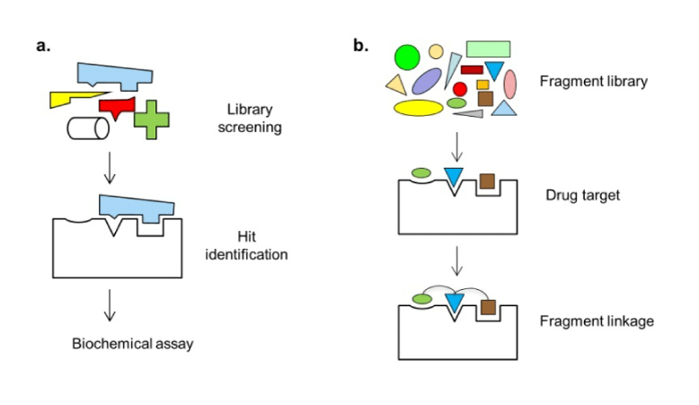
Screening Methods
Phenotypic Screening:
Target-Based Approach:
Whole-cell assay
Assume physiological relevance
Physicochemical properties of hits NB – need to get into cell
No assumption of target/pathway/mechanisms (efficacy and toxicity)
Target deconvolution – elucidate MOA
Based on known target
Develop biochemical assay
Target validation required
Assume MOA
Recombinant technology and genetics
Assisted by SBDD

Slide 8
Screening Methods
Phenotypic Screening:
Target-Based Approach:
Whole-cell assay
Assume physiological relevance
Physicochemical properties of hits NB – need to get into cell
No assumption of target/pathway/mechanisms (efficacy and toxicity)
Target deconvolution – elucidate MOA
Based on known target
Develop biochemical assay
Target validation required
Assume MOA
Recombinant technology and genetics
Assisted by SBDD
Fragment-Based Screening:
Relatively small libraries of fragments sample chemical space widely
Though weak in potency, fragments can form high energy interactions
Ligand Efficiency (LE) is a way to judge differently sized molecules
Low MW, improved target selectivity and ease of chemical synthesis

Slide 9
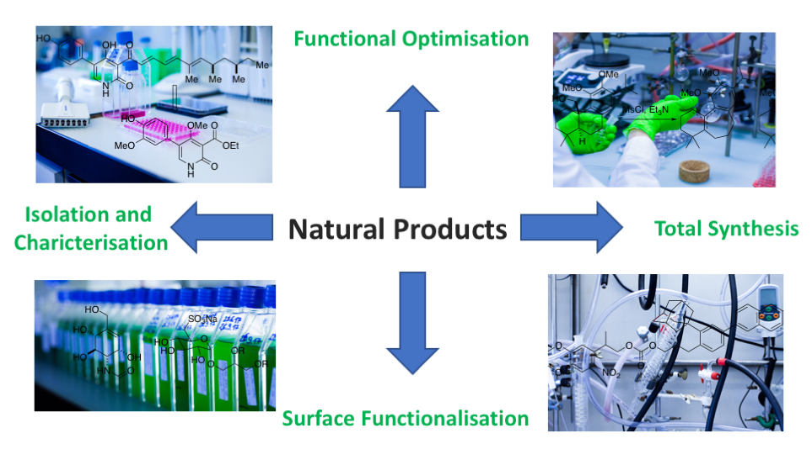
Screening Methods
Phenotypic Screening:
Target-Based Approach:
Whole-cell assay
Assume physiological relevance
Physicochemical properties of hits NB – need to get into cell
No assumption of target/pathway/mechanisms (efficacy and toxicity)
Target deconvolution – elucidate MOA
Based on known target
Develop biochemical assay
Target validation required
Assume MOA
Recombinant technology and genetics
Assisted by SBDD
Fragment-Based Screening:
Natural Products:
Relatively small libraries of fragments sample chemical space widely
Though weak in potency, fragments can form high energy interactions
Ligand Efficiency (LE) is a way to judge differently sized molecules
Low MW, improved target selectivity and ease of chemical synthesis
Sources: plants, microbials, marine life, toxins etc.
Isolation, characterization and structural elucidation can be challenging
Synthesis, semi-synthesis, chemical modifications, biosynthesis and scale-up

Slide 10
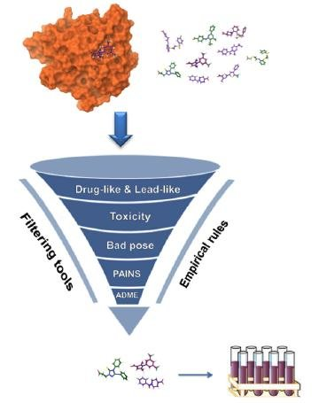
Screening Methods
Phenotypic Screening:
Target-Based Approach:
Whole-cell assay
Assume physiological relevance
Physicochemical properties of hits NB – need to get into cell
No assumption of target/pathway/mechanisms (efficacy and toxicity)
Target deconvolution – elucidate MOA
Based on known target
Develop biochemical assay
Target validation required
Assume MOA
Recombinant technology and genetics
Assisted by SBDD
Virtual Screening:
Known target with crystal structure
Can dock large library of compounds to identify those with suitable binding
Apply ML techniques
Fragment-Based Screening:
Natural Products:
Relatively small libraries of fragments sample chemical space widely
Though weak in potency, fragments can form high energy interactions
Ligand Efficiency (LE) is a way to judge differently sized molecules
Low MW, improved target selectivity and ease of chemical synthesis
Sources: plants, microbials, marine life, toxins etc.
Isolation, characterization and structural elucidation can be challenging
Synthesis, semi-synthesis, chemical modifications, biosynthesis and scale-up

Slide 11
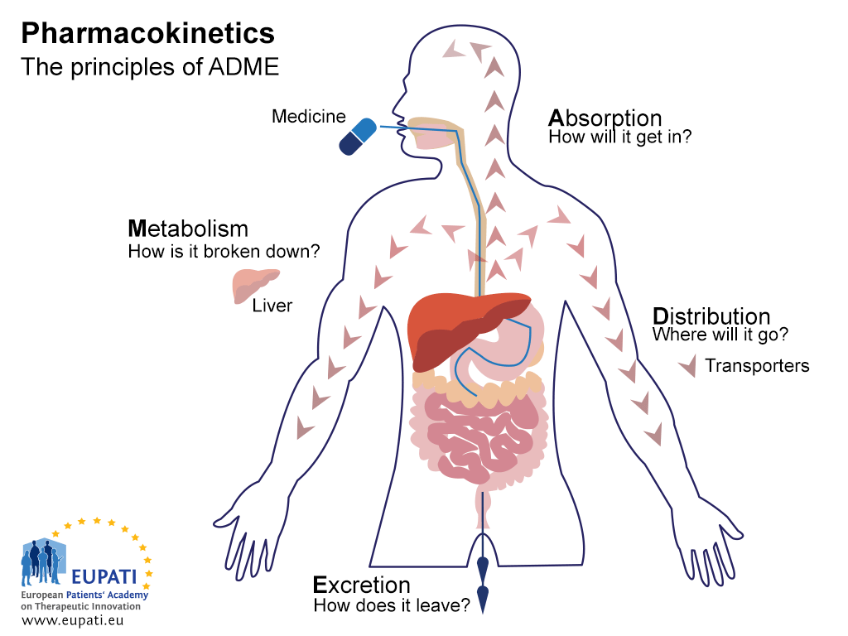
In vitro ADMET
ADMET Assays
Solubility
Metabolic Stability (m/r/h)
Metabolite Identification
Cyp Inhibition
Permeability (Caco-2 or PAMPA)
Plasma Protein Binding
Cytotoxicity
hERG

Slide 12
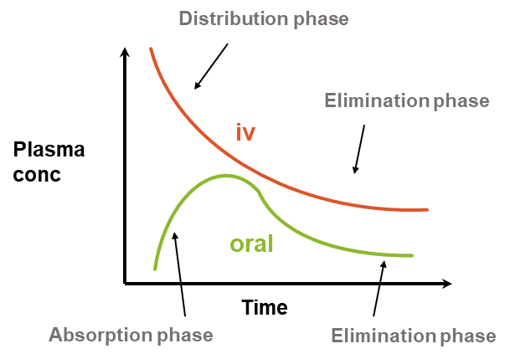
In vivo Pharmacokinetics
Absorption |  |  |  | Elimination |  |  | Distribution
Permeability |  | Efflux | Aqueous solubility | Renal excretion | Metabolic stability | Biliary excretion | Protein binding | Tissue binding
fa |  |  |  | Clearance (Cl) |  |  | Vd
 |  |  | Bioavailability (F) |  |  | Half-life (t_{1/2})
How much?
How often?

Slide 13
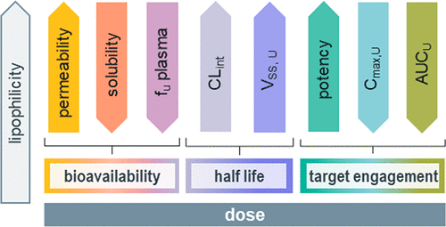
Chemical Properties
Polarity
Lipophilicity
Basicity
Topological polar surface area (TPSA)
Sum of surfaces of polar atoms (O, N, P)
Increasing polarity results in:
Solubility
Permeability
hERG
Measured or calculated LogD or LogP
Ability to mix with oils/fats rather than water (partition coefficient)
Increasing lipophilicity results in:
Solubility
Permeability
Metabolism
hERG
Potency
pKa is a measure of the strength of an acid (or base)
Adding ionizable group/increasing basicity results in:
Solubility
Permeability
hERG
J. Med. Chem. 2020, 63, 21, 12156–1217
Notes:
Increase in lipophilicity also increases hERG potential

Slide 14
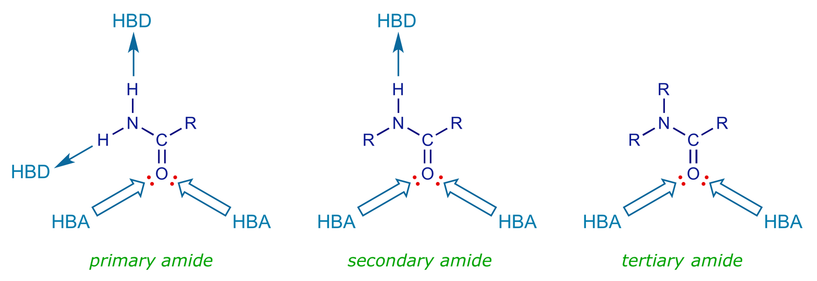
Chemical Properties
Hydrogen Bonding
Molecular Weight
Drug-Like Properties
HBD or HBA
Involved in binding interactions
Increasing H-bonding results in:
Solubility
Permeability
hERG
Potency
Size of the molecule
Start small and get bigger
Increasing MW results in:
Solubility
Permeability
Potency
RO5 (Lipinski):
H-bond donors < 5
N + O < 10
MW < 500
cLogP < 5
RO3 (hits):
H-bond donors < 3
N + O < 6
MW < 300
cLogP < 3
Notes:
Increase in lipophilicity also increases hERG potential

Slide 15
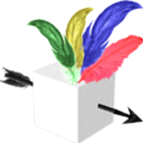
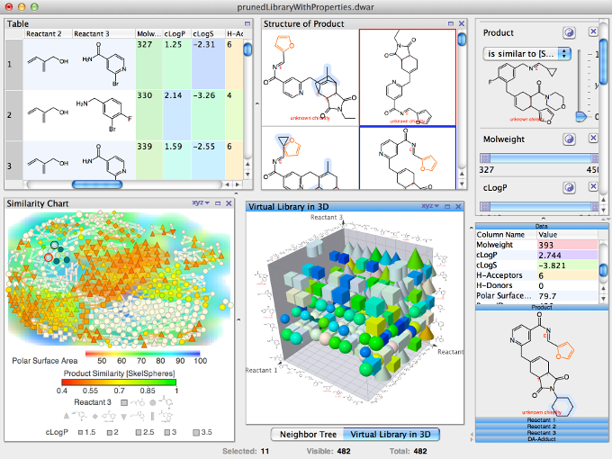


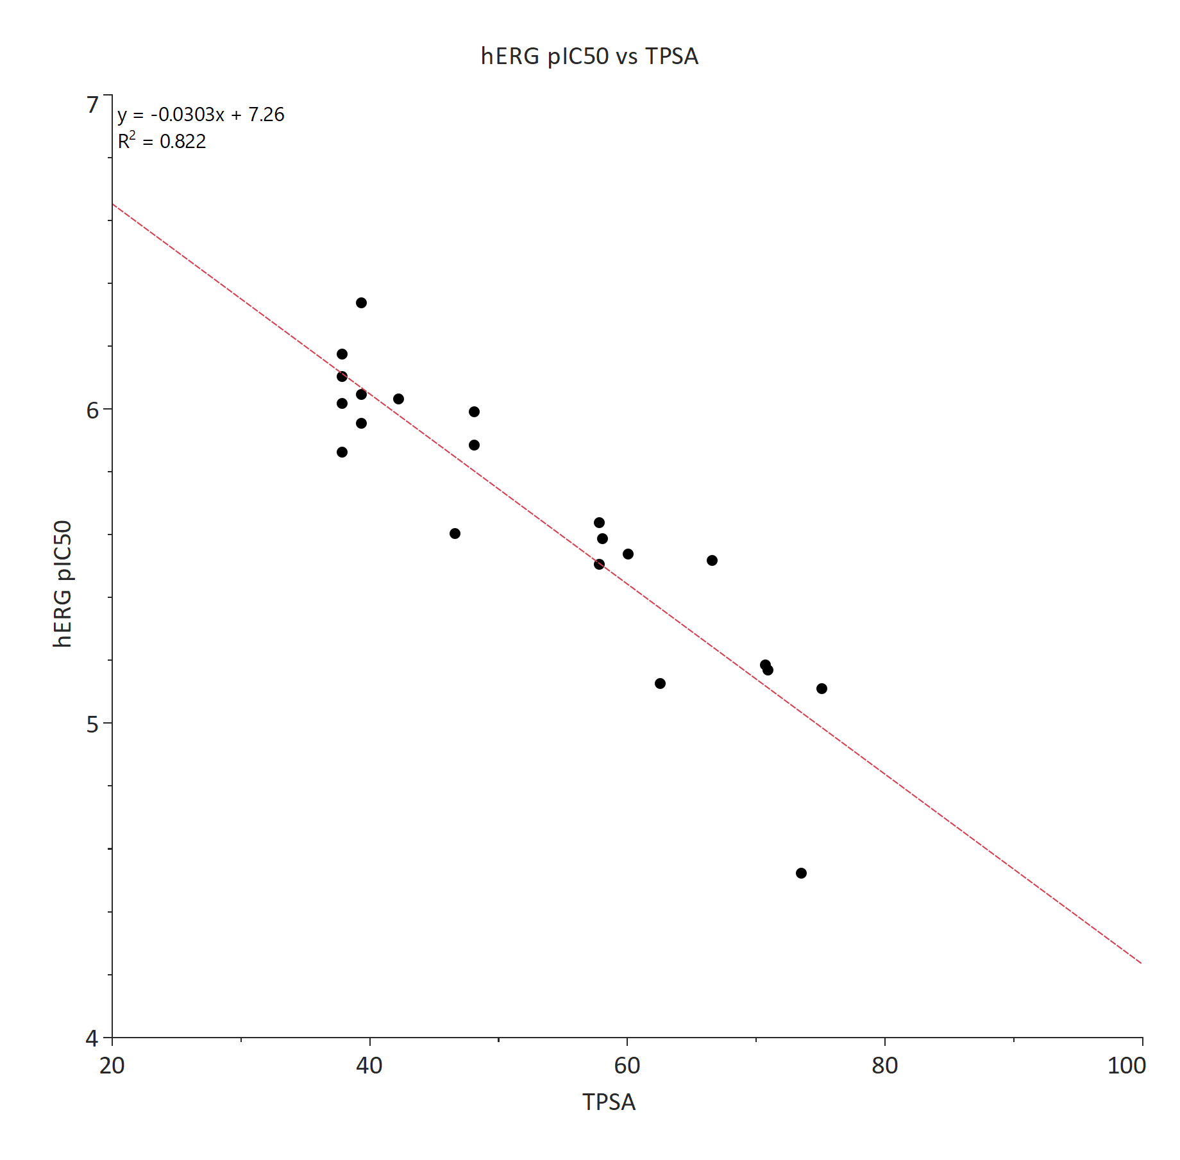
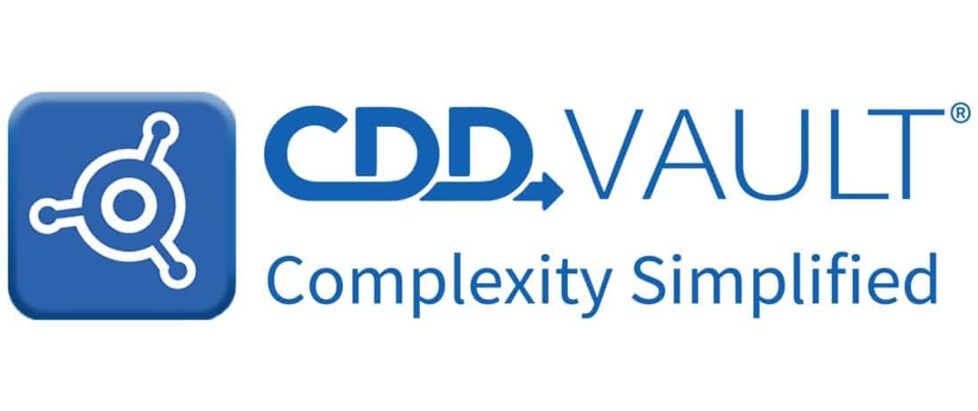

Tools to Calculate Properties
Data Warrior

Slide 16
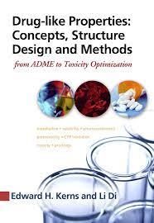
Summary
In vitro
Solubility
Permeability
Binding
LogD
pKa
Metabolism
Toxicity
In vitro
Biochemical Assay
Whole-cell assay
Synthesis
Activity
Optimization
Property
In vivo
In vivo
Animal Model
Pharmacokinetics
Redesign

Slide 17
Bringing data science and AI/ML tools to infectious disease research
Session 1: Applications of AI in Drug Discovery

Slide 18
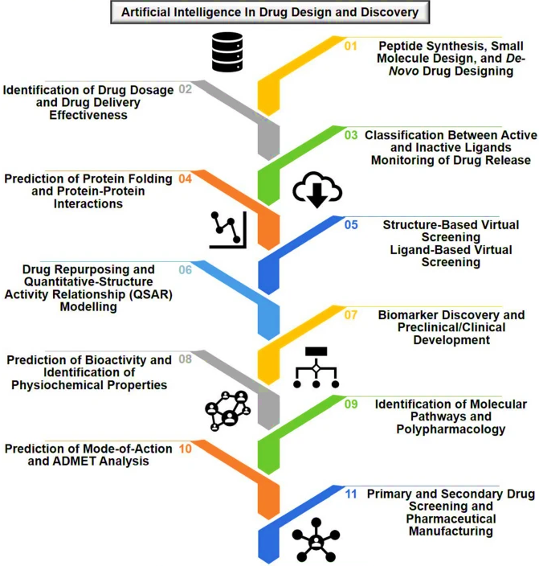
AI/ML in Drug Discovery
Molecular Diversity (2021) 25:1315-1360.

Slide 19

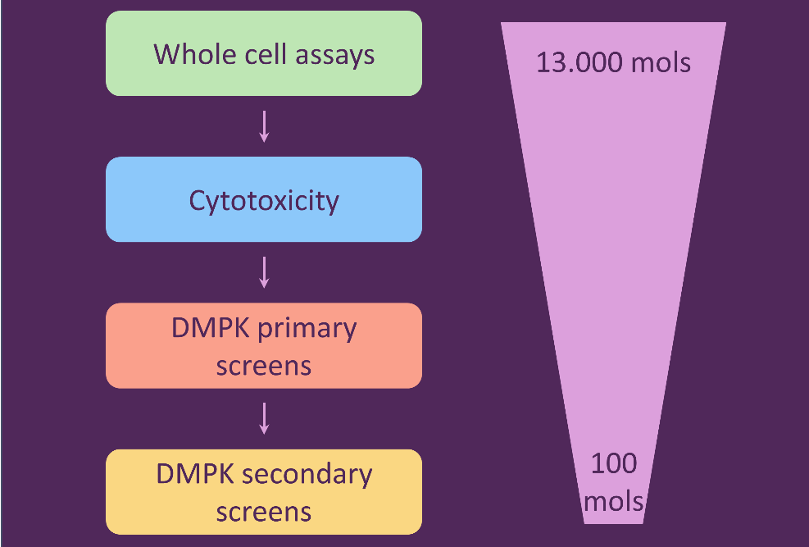
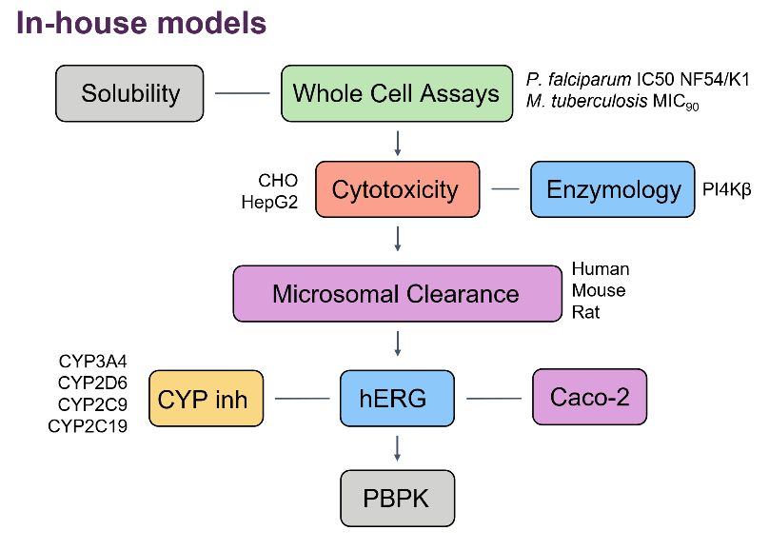
Ersilia Collaboration
Virtual Screening Cascade
(Manuscript in progress)
Automated ML pipeline for drug discovery assays.
Models assembled into a virtual screening cascade.

Slide 20
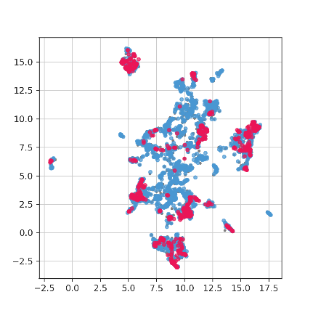
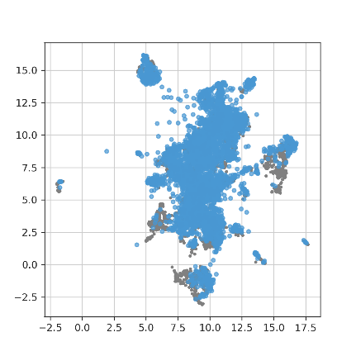
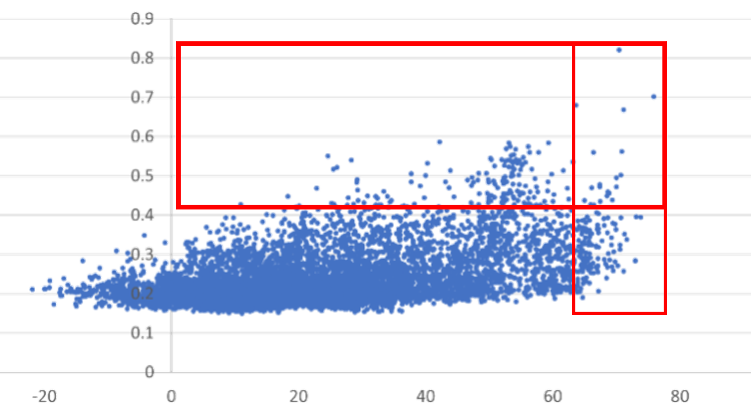
AI/ML Virtual Screening
Screening
Formal Hit
Assessment
Hit to Lead
Lead Optimisation
Pre-clinical
development
H3D Plasmodium Library
Plasmodium Screening Library
Virtual Screening for Plasmodium Hits
H3D Model Score
(Bigger score is better)
Literature Model Score
(Bigger score is better)
Visualise chemical diversity between datasets.
AI/ML based virtual screening for new chemical hits in malaria, tuberculosis and AMR.

Slide 21
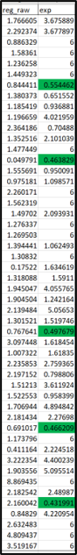
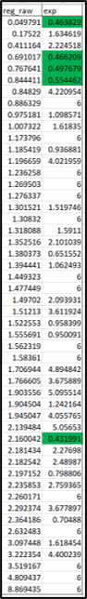
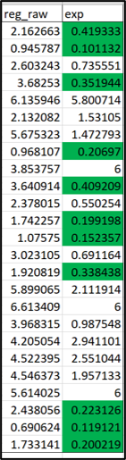
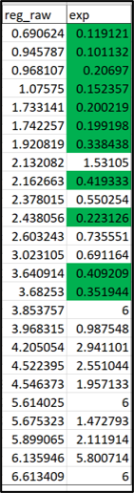
Prioritising Analogues
Screening
Formal Hit
Assessment
Hit to Lead
Lead Optimisation
Pre-clinical
development
Date ordered
Date ordered
Model
Model
Series 1:
Series 2:
Prioritisation of analogues for synthesis.

Slide 22
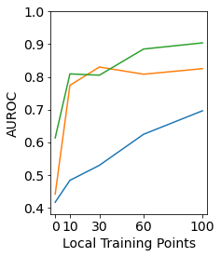
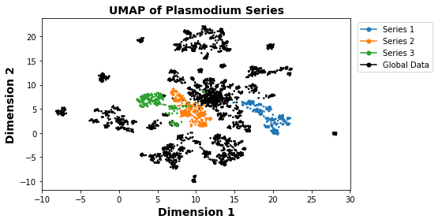
Data Exploration
Screening
Formal Hit
Assessment
Hit to Lead
Lead Optimisation
Pre-clinical
development
Model Performance
Investigating the effect of the volume of training data on model performance.

Slide 23
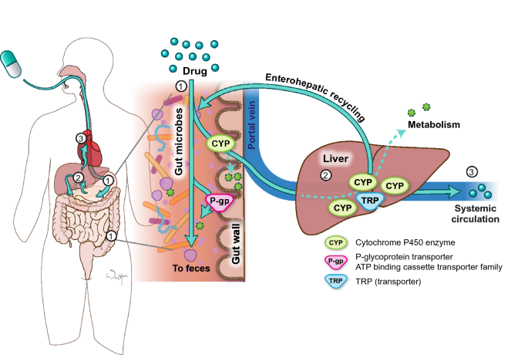

Drug Metabolism
Screening
Formal Hit
Assessment
Hit to Lead
Lead Optimisation
Pre-clinical
development
Tsunoda, S. M., et al. Clinical pharmacokinetics, 60(8), 971-984.
https://www.psychologicalscience.org/news/releases/exploring-the-genetics-of-ill-do-it-tomorrow.html
Gut microbiome and liver drug metabolism.
Understanding pharmacogenetics in an African population.

Slide 24

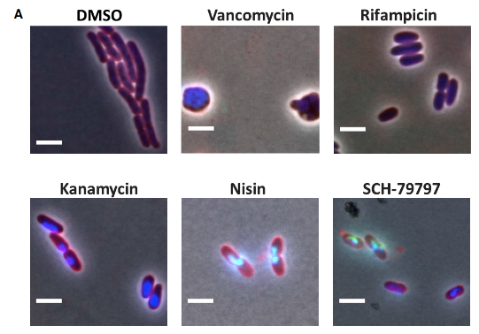
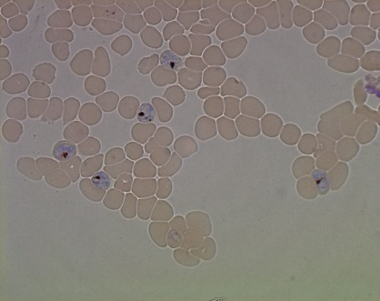
Mechanism of Action Study
P. falciparum ??
Martin II, J. K., et. al. (2020). Cell, 181(7), 1518-1532.
Live cell imaging for anti-malarial MoA studies.
Using convolutional neural networks (CNNs).

